Slide 1
Why Productivity Varies Around the World
William W. Lewis
Stern School of Business NYU
April 29, 2008

Slide 2
WORLD DISTRIBUTION OF PER CAPITA GDP BY COUNTRY
U.S. Dollars, at PPP
High income countries
Middle income countries
GDP per capita, 2002
U.S. 2002 $ thousands
Low income countries
Norway
Canada
Germany
U.S.
France
U.K.
Japan
Italy
Spain
Korea
Poland
South Africa
Mexico
Russia
Brazil
Pakistan
Vietnam
Indonesia
Nigeria
Bangladesh
China
India
Population
Millions
Notes:
DCO-ZXE089-20040200-jgfPP1

Slide 3
ECONOMIC DEVELOPMENT PATHS
Percent U.S. 1995 level
GDP per capita
Percent
100
U.S. (1890
-
1995)
90
80
W. Germany
(1970
-
95)
70
France
(1970
-
95)
Japan
60
(1950
-
95)
50
U.K.
40
(1970
-
95)
Korea (1970
-
95)
30
Brazil
20
(1960
-
95)
X
X
10
India
Russia (1997)
(1970
-
99)
Poland (1997)
0
0
20
40
60
80
100
120
140
Total labor and capital inputs per capita
Notes:
DCO-ZXE089-20040200-jgfPP1

Slide 4
GDP per
capita
Employment
Labor
productivity
=
x
Capita
  Skill level of personnel
  Organization of functions and tasks, marketing and other operational factors
  Capital and technology
  Scale and capacity utilization
Notes:
DCO-ZXE089-20040200-jgfPP1
Why do we study labor productivity?
A country's wealth is determined by such a key economic parameter as GDP per capita.
As follows from the above-given formula, GDP level is determined by two variables: employment and labor productivity. However, employment level (per capita) in most countries is approximately the same and limited by demographic factors. Therefore, labor productivity is the most important source of GDP growth.
Labor productivity, in turn, is determined by several factors most important of which appear on the chart.
Thus, when studying labor productivity, we take into account all the above-listed factors which can either thwart or stimulate economic growth.

Slide 5
CONCLUSIONS
  Sector level analysis is necessary to find causal factors of economic performance
  Education is not as immediately important as most people think
  Distortions in competition in product markets are more important than labor or capital
  market problems
  Distorting markets to achieve social equity objectives is usually a bad idea
  Today’s big governments in poor countries are a handicap today’s rich countries did not have when they were poor
  Consumers are the only political force that can stand up to producer interests, big government, and the technocratic, political, business, and intellectual elites
Notes:
DCO-ZXE089-20040200-jgfPP1

Slide 6
CONCLUSIONS
  Sector level analysis is necessary to find causal factors of economic performance
  Education is not as immediately important as most people think
  Distortions in competition in product markets are more important than labor or capital
  market problems
  Distorting markets to achieve social equity objectives is usually a bad idea
  Today’s big governments in poor countries are a handicap today’s rich countries did not have when they were poor
  Consumers are the only political force that can stand up to producer interests, big government, and the technocratic, political, business, and intellectual elites
Notes:
DCO-ZXE089-20040200-jgfPP1

Slide 7
DUAL ECONOMY IN JAPAN
11 Industries
Relative productivity levels
Index U.S. = 100
160
Steel
140
Automotive parts
Metal working
120
Cars
Consumer electronics
100
Computers
U.S. = 100
80
Soap and detergent
Beer
60
Food processing
40
Retail
Housing construction
20
0
0
10
20
30
40
50
60
70
80
90
100
Employment
100% = 12.473 million employees
Notes:
DCO-ZXE089-20040200-jgfPP1

Slide 8
CONCLUSIONS
  Sector level analysis is necessary to find causal factors of economic performance
  Education is not as immediately important as most people think
  Distortions in competition in product markets are more important than labor or capital
  market problems
  Distorting markets to achieve social equity objectives is usually a bad idea
  Today’s big governments in poor countries are a handicap today’s rich countries did not have when they were poor
  Consumers are the only political force that can stand up to producer interests, big government, and the technocratic, political, business, and intellectual elites
Notes:
DCO-ZXE089-20040200-jgfPP1

Slide 9
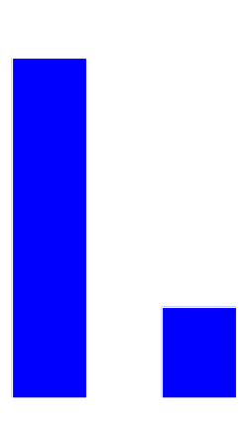

BLUE COLLAR TRAINABILITY – CONSTRUCTION OF
SUBSIDIZED HOUSING
Labor productivity
M²/thousand hours
Construction cost
U.S.$/M²
Organization of labor
U.S.
Brazil
Brazilian gap
Subcontractors
40
10
  Less specialized
Blue collar background
Mexican agriculture
Brazilian northeast agriculture
  Similar educational background
U.S.
(Houston)
Brazil
(São Paulo)
U.S.
Brazil
Notes:
DCO-ZXE089-20040200-jgfPP1

Slide 10
CONCLUSIONS
  Sector level analysis is necessary to find causal factors of economic performance
  Education is not as immediately important as most people think
  Distortions in competition in product markets are more important than labor or capital
  market problems
  Distorting markets to achieve social equity objectives is usually a bad idea
  Today’s big governments in poor countries are a handicap today’s rich countries did not have when they were poor
  Consumers are the only political force that can stand up to producer interests, big government, and the technocratic, political, business, and intellectual elites
Notes:
DCO-ZXE089-20040200-jgfPP1

Slide 11
LABOR PRODUCTIVITY, OUTPUT, AND EMPLOYMENT IN U.S. COMMERCIAL BANKS
Indexed to 1980 = 100
150
140
130
120
Output
110
Productivity
Employment
100
90
Deregulation
80
70
60
1970
72
74
76
78
80
82
84
86
90
1992

Slide 12



INDIAN AUTOMOTIVE INDUSTRY
Index: India = 100 in 1992-93
Labour productivity
Output
Employment
  Barriers
  removed
  Licensing abolished
  FDI allowed
256% increase
280% increase
11% increase
1992-93
1999-2000
1992-93
1999-2000
1992-93
1999-2000
Notes:
DCO-ZXE089-20040200-jgfPP1

Slide 13
CONCLUSIONS
  Sector level analysis is necessary to find causal factors of economic performance
  Education is not as immediately important as most people think
  Distortions in competition in product markets are more important than labor or capital
  market problems
  Distorting markets to achieve social equity objectives is usually a bad idea
  Today’s big governments in poor countries are a handicap today’s rich countries did not have when they were poor
  Consumers are the only political force that can stand up to producer interests, big government, and the technocratic, political, business, and intellectual elites
Notes:
DCO-ZXE089-20040200-jgfPP1

Slide 14
IMPORTANCE OF LOW SKILLED LABOR IN THE U.S. – 1995
Number of jobs in the U.S.
26%
WAGE COSTS
U.S. minimum wage costs
(U.S. $ 5.1)
French minimum wage costs
(U.S. $ 9.3)

Slide 15
CONCLUSIONS
  Sector level analysis is necessary to find causal factors of economic performance
  Education is not as immediately important as most people think
  Distortions in competition in product markets are more important than labor or capital
  market problems
  Distorting markets to achieve social equity objectives is usually a bad idea
  Today’s big governments in poor countries are a handicap today’s rich countries did not have when they were poor
  Consumers are the only political force that can stand up to producer interests, big government, and the technocratic, political, business, and intellectual elites
Notes:
DCO-ZXE089-20040200-jgfPP1

Slide 16
GOVERNMENT SPENDING VS. GDP PER CAPITA
Government spending
As percent of GDP
40
35
Brazil (2000)
India (2000)
U.S. (2000)
30
Russia (1998)
25
20
Japan (1950)
15
France (1913)
10
5
U.S. (1913)
0
0
5,000
10,000
15,000
20,000
25,000
30,000
GDP per capita
1990 U.S.$

Slide 17
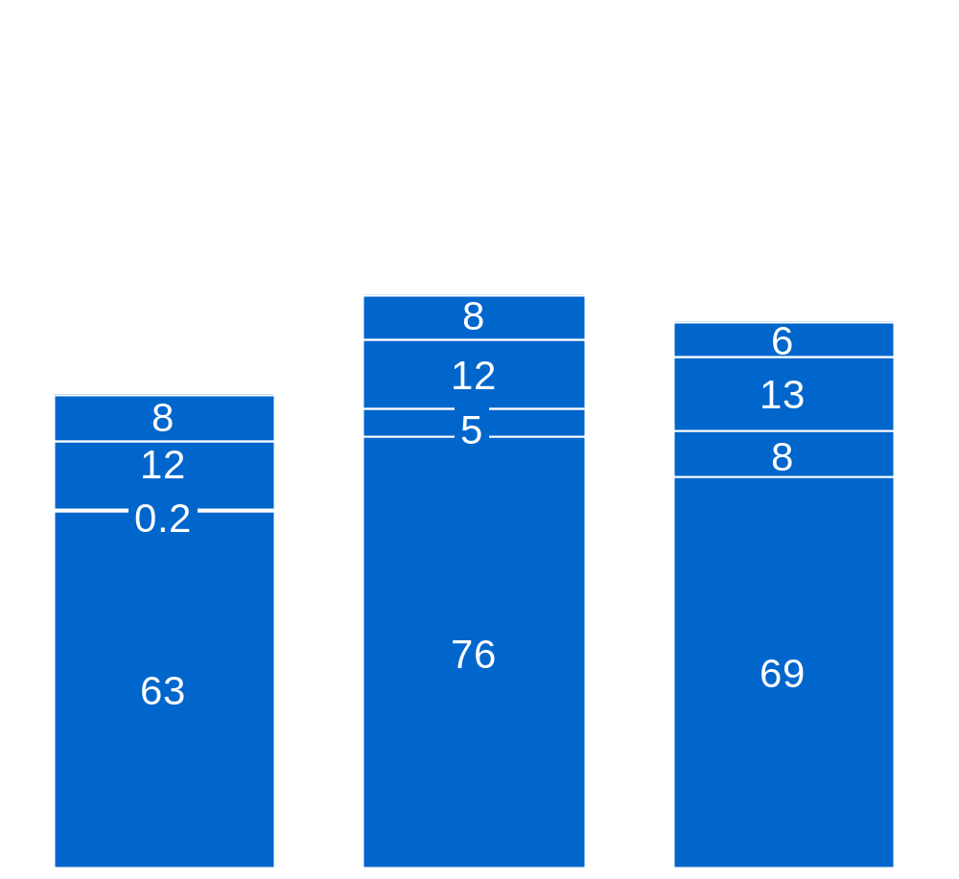
SUPERMARKETS AND INFORMAL MARKETS IN RUSSIA
Index price in gastronoms = 100
101
96
Price
83
Net margin
Operating expenses
Taxes
Cost of goods
1998
With equal laws and enforcement
Supermarkets
1998
Retail/wholesale markets
Notes:
DCO-ZXE089-20040200-jgfPP1

Slide 18
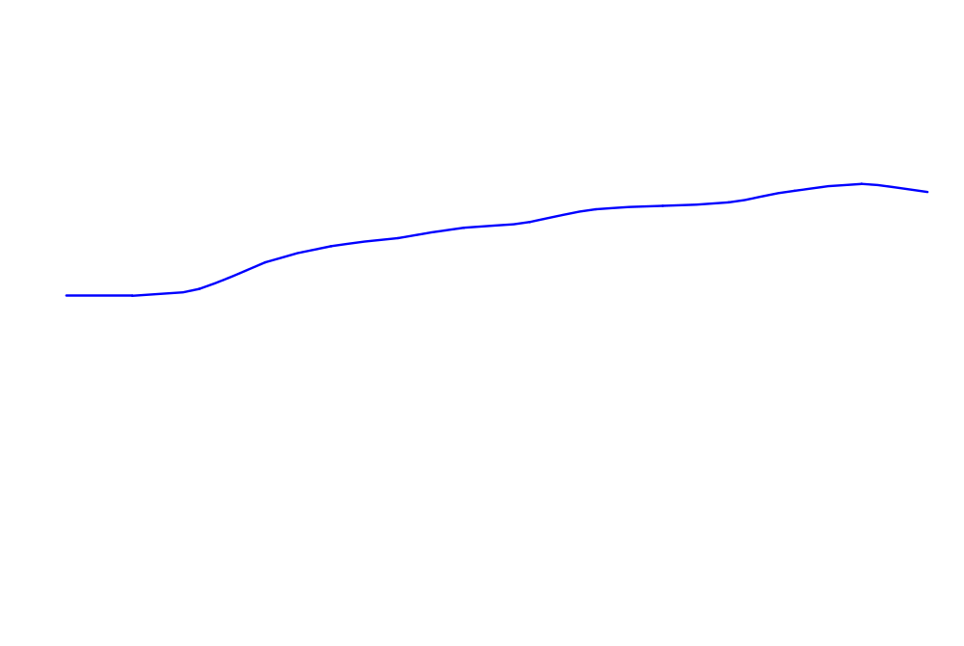
INFORMALITY IN BRAZIL
Percent urban employment
Formal
Informal
Notes:
DCO-ZXE089-20040200-jgfPP1

Slide 19
CONCLUSIONS
  Sector level analysis is necessary to find causal factors of economic performance
  Education is not as immediately important as most people think
  Distortions in competition in product markets are more important than labor or capital
  market problems
  Distorting markets to achieve social equity objectives is usually a bad idea
  Today’s big governments in poor countries are a handicap today’s rich countries did not have when they were poor
  Consumers are the only political force that can stand up to producer interests, big government, and the technocratic, political, business, and intellectual elites
Notes:
DCO-ZXE089-20040200-jgfPP1

Slide 20
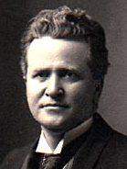

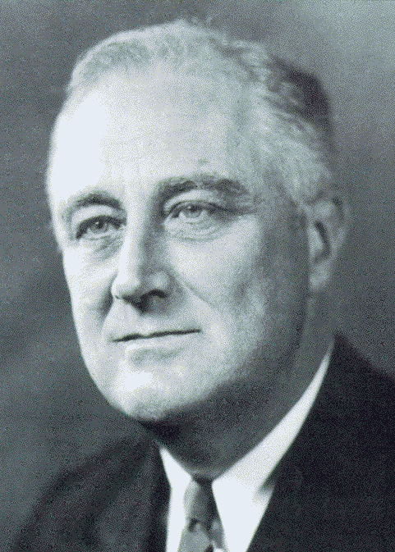

Consumers have political clout
US Consumer advocacy
1906, Senator Robert La Follette
“The welfare of all the people as consumers should be the supreme consideration of the government.”
1914, Walter Lippman
“We hear a great deal about the class-consciousness of labour. My own observation is that in America today consumers’ consciousness is growing very much faster.”
1932, President Franklin Roosevelt
“I believe that we are at the threshold of a fundamental change in our popular economic thought; in the future, we’re going to think less about the producer and more about the consumer.”
1960, John F. Kennedy
“The consumer is the only man in our economy without a high-powered lobbyist. I intend to be that lobbyist.”

